Slide 1
Heat Map of EVT2.1B Phone with CSP Bar

Slide 2
Test Setup
CSP bar. 36LED chips
Build 433 - 3D LED current is limited to 14mA
Turn off thermal engine (2D and 3D backlight)
Turn off GPU/CPU thermal control
No USB charging

Slide 3
Feature | Max Temperature (C) | Comment | EVT1 Power (from David) (W) | EVT2.1b. Additional Power (W)
Sleep | 24.7C. Mostly uniform temperature |  | 0 | 0.0032
System (LCD on, 2D Brightness = 0) | 28.3C at LCD circuit | LCD circuit adds 4.5C | 0.4 | 0.46
2D Brightness = 255 (450nits, not boost mode) | 40.2C at LCD circuit | 2D LED Bar adds 12C | 1.5 | 1.7 - 0.46 = 1.24
3D Brightness = 255 | 46.9C at LCD circuit | 3D LED Bar adds 19C | 3.6 | 3.8 - 0.46 = 3.34 - this is based on 18LED bar at 25mA. Need to retest
Red Player, 2x2, no 4V | 48.2C at LCD circuit | Main board temp increases by 2.6C | 0.8 | 4.8 -0.46 - 3.34 = 1
Red Player, 2x1, 4V | 48C at LCD circuit | Main board temp increases by 3.7C | 0.8 | 5.9 - 0.46 - 3.34 = 2.1
Wifi Movie Streaming | 48.6C at LCD circuit | Main board temp increases by 4C |  | 6.4 - 0.46 - 3.34 = 2.6
Dungeon, Low GPU = 180MHz | 48C at LCD circuit | Main board temp increases by 2.7C |  | 5.0 - 0.46 - 3.34 = 1.2
Dungeon, High GPU = 710MHz | 57C at LCD circuit | Main board temp increases by 17C | 2.1 | 9.5 - 0.46 - 3.34 = 6
3D Front Camera, No 4V | 49C at LCD circuit | Main board temp increases by 7.5C | 1.9 | 6.5 - 0.46 - 3.34 = 2.7
3D Front Camera, 4V | 53C at LCD circuit | Main board temp increases by 12C |  | 8.5 - 0.46 - 3.34 = 4.7
3D Back Camera, No 4V | 50C at LCD circuit | Main board temp increases by 7C | 2.6 | 6.1 - 0.46 - 3.34 = 2.3
3D Back Camera, 4V | 51C at LCD circuit | Main board temp increases by 9C |  | 7.1 - 0.46 - 3.34 = 3.3

Slide 4
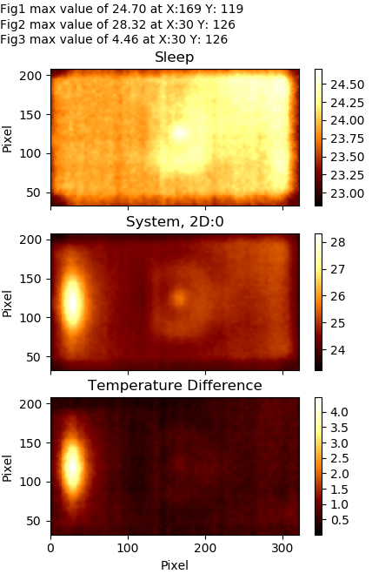
04/25/2018
Sleep v. System
Ambient Temp = 23C
System was on for 25min
Turning on the LCD increases temp by 4.5C
Main board area increase by 1C.

Slide 5
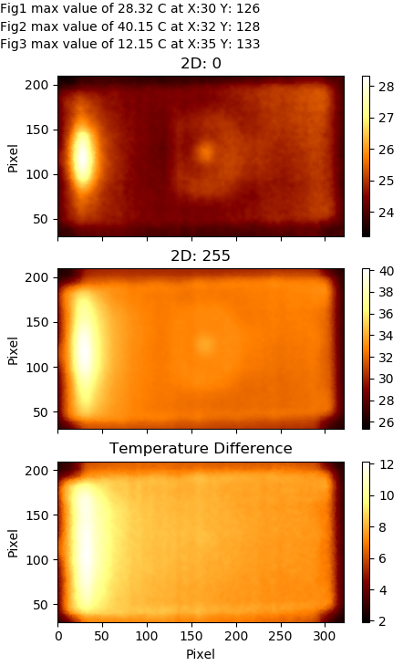
04/25/2018
System v. 2D On at 255/255 Brightness
Ambient Temp = 23C
System was on for 15min
GPU Freq: 257MHz
Turning on the 2D Backlight increases temp by 12C at the 2D LED bar

Slide 6
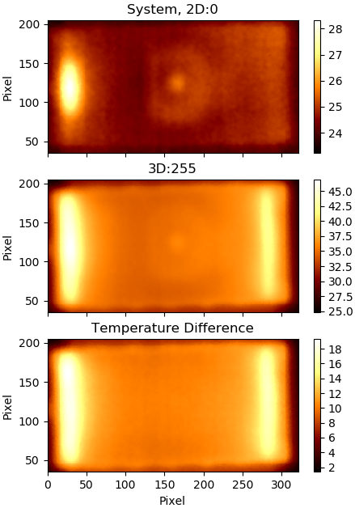
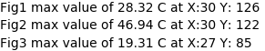
04/25/2018
System v. 3D (CSP Bar) On at 255/255 Brightness
Ambient Temp = 23C
System was on for 25min
Turning on the 3D Backlight increases temp by 19C at the two 3D LED bar areas

Slide 7
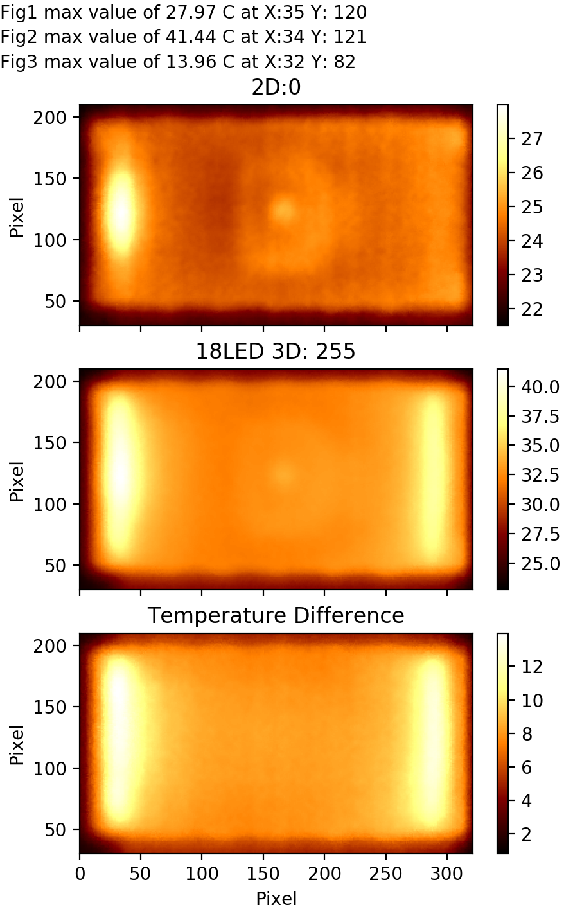
05/01/2018
System v. 3D (18LED) On at 255/255 Brightness
Ambient Temp = 22C
System was on for 45min
Turning on the 3D Backlight (18LED) increases temp by 14C at the two 3D LED bar areas

Slide 8
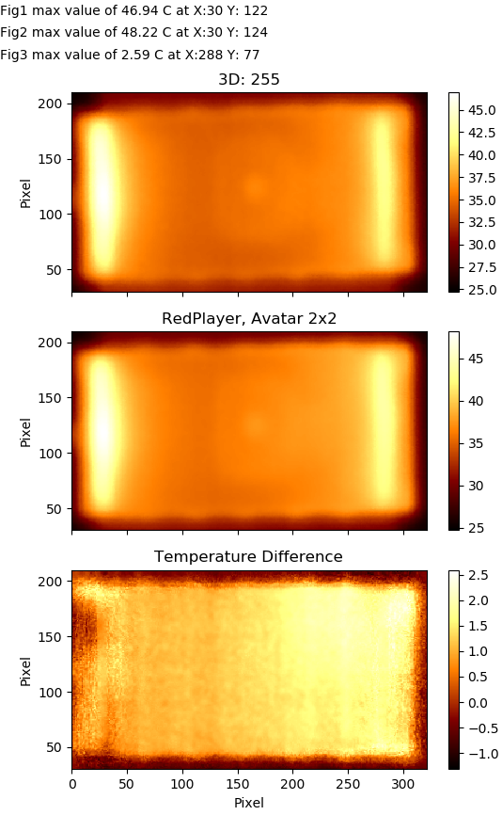
04/25/2018
3D: 255 v. Red Player Playing Avatar (2x2)
Ambient Temp = 23C
RedPlayer was on for 30min
GPU Frequency: 710MHz
Dungeon FPS: 35
Using the Red Player increases phone temperature by 2.6C at the main board area

Slide 9
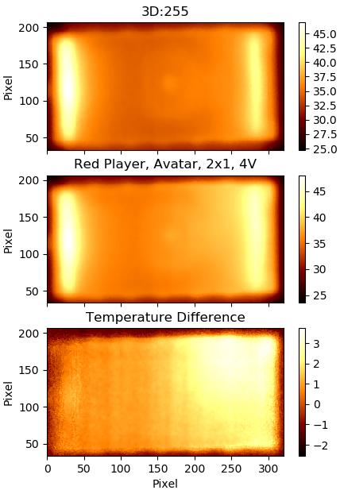
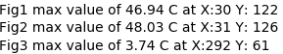
04/26/2018
3D: 255 v. Red Player Playing Avatar (2x1, 4V)
Ambient Temp = 22C
RedPlayer was on for 30min
GPU Frequency: 710,000,000
Using the Red Player increases phone temperature by 3.7C at the main board area

Slide 10
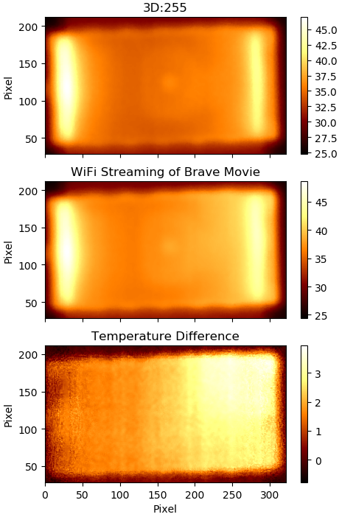
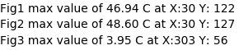
04/26/2018
3D: 255 v. WiFi Streaming of movie
Ambient Temp = 22C
RedPlayer was on for 30min
GPU Frequency: 257MHz
Using WiFi to stream movies, the phone temp increases by 4C at the main board area

Slide 11
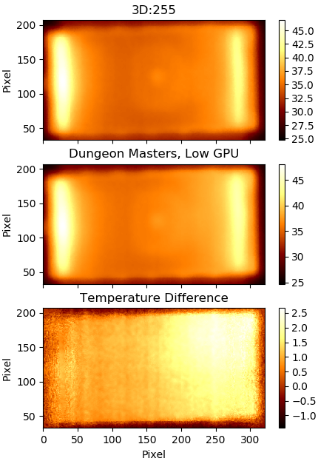
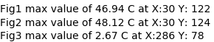
04/26/2018
3D: 255 v. Dungeon Masters Low GPU
Ambient Temp = 23C
DungeonMasters was running for 50min
GPU Frequency: 180,000,000
Dungeon FPS: 10
Playing Dungeon Masters increases phone temperature by 2.7C at the main board area

Slide 12
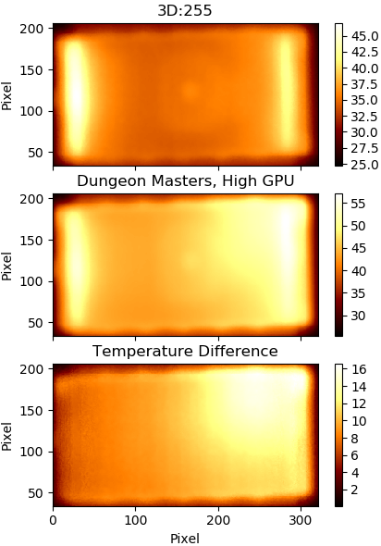
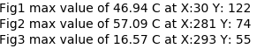
04/26/2018
3D: 255 v. Dungeon Masters High GPU
Ambient Temp = 23C
DungeonMasters was running for 30min
GPU Frequency: 710MHz
Dungeon FPS: 35
Playing Dungeon Masters with high GPU increases phone temperature by 17C at the main board area

Slide 13
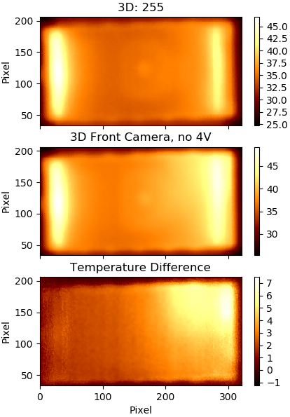
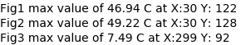
04/25/2018
3D: 255 v. 3D Front Camera
Ambient Temp = 23C
3D Camera was running for 20min
GPU Frequency: 257MHz
3D Cam FPS: 30
Using the 3D Camera increases phone temperature by 7.5C at the main board area

Slide 14
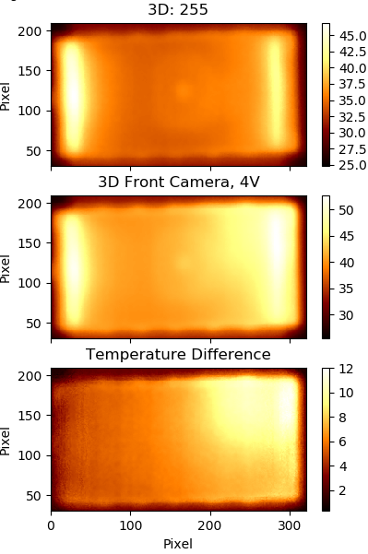
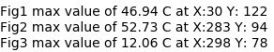
04/25/2018
3D: 255 v. 3DCamera_4V_Front
Ambient Temp = 23C
3DCamera was running for 10min
GPU Frequency: 710MHz
3D Cam FPS: 17
Using the 3D Camera increases phone temperature by 12C at the main board area

Slide 15
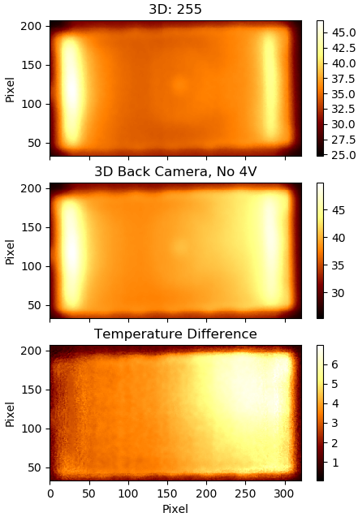
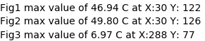
04/25/2018
3D: 255 v. 3DCamera, Back, No 4V
Ambient Temp = 23C
Running for 10min
GPU Frequency: 257000000
3D Cam FPS: 13
Using 3D camera increases phone temperature by 7C at the main board area

Slide 16
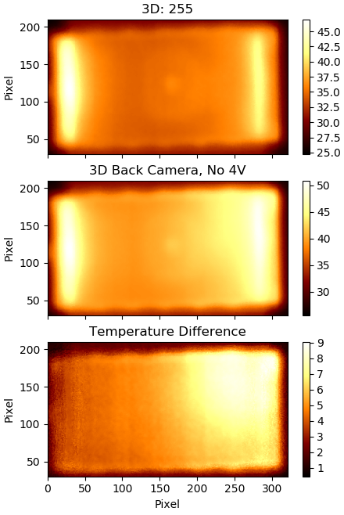
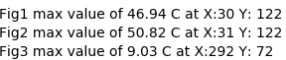
04/25/2018
3D: 255 v. 3DCamera, Back, 4V
Ambient Temp = 23C
Running for 10min
GPU Frequency: 710000000
3D Cam FPS: 13
Using 3D camera increases phone temperature by 9C at the main board area

Slide 17
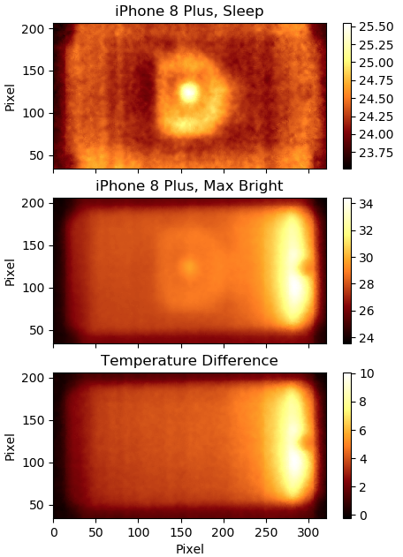
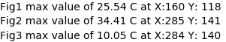
05/01/2018
iPhone 8 Plus
Ambient Temp = 22C
Running for 30min
Airplane Mode
Phone temperature increases by 10C at the LED area

Slide 18
04/25/2018
NOTES

Slide 19
04/25/2018
NOTES
Turn off thermal engine
If you need to evaluate 3D backlight thermal, please disable 3D thermal policy, using attached configuration:
1. adb root
2. adb remount #if failed, please run adb disable-verity, adb reboot
3. adb push your_path/thermal-engine.conf /vendor/etc/thermal-engine.conf
Comment out algo_type in GPU_management, LCD_management,LCD_3D_management
4. adb reboot
5. adb root
6. adb shell #not necessary
7. cd /sys/class/thermal #not necessary
8. while true;do echo quiet_therm;cat thermal_zone7/temp;sleep 1;done #not necessary
9. do your test
Change to Low GPU for gaming (Dungeon Masters)
cd /sys/class/kgsl/kgsl-3d0
echo 180000000 > max_gpuclk
Change to High GPU for gaming (Dungeon Masters)
cd /sys/class/kgsl/kgsl-3d0
echo 710000000 > max_gpuclk
Turn off USB charging (1=off, 0 = on)
echo 1 > /sys/class/power_supply/battery/input_suspend

Slide 20
04/25/2018
NOTES
Verizon Test Parameters
When the ambient temperature is below 40 C/111.2 F, the case temperature (at any point on the case) of the device shall not be greater than 20 C above the ambient temperature under any user usage scenarios with the following maximal temperature limitation on different case materials:
· Metal : 44 C (111.2 F)
· Glass and Ceramic: 50 C (122 F)
· Plastic and Rubber: 55 C (131 F)

Slide 21
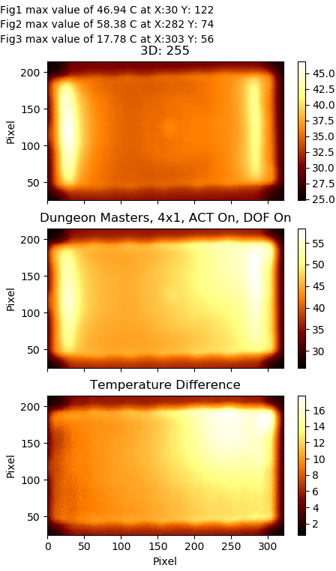
04/25/2018
3D: 255 v. Dungeon Masters
Ambient Temp = 23C
DungeonMasters was running for 1h20min
Dungeon FPS: 35
Playing Dungeon Masters increases phone temperature by 18C at the main board area

Slide 22
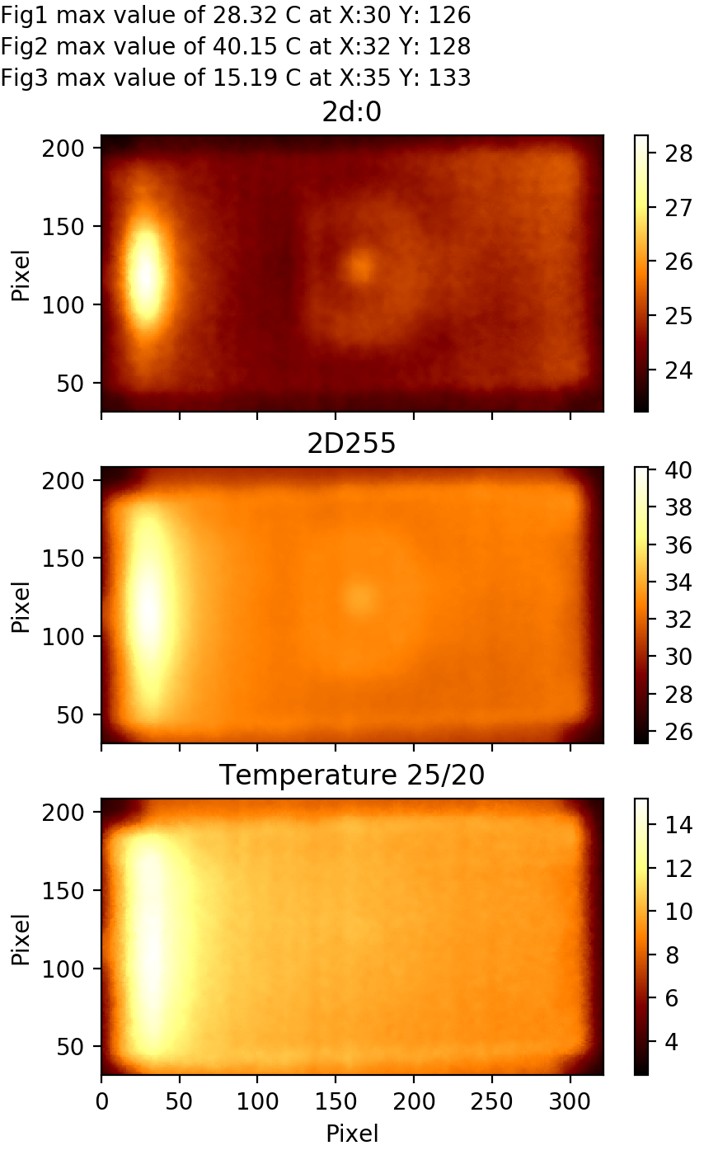
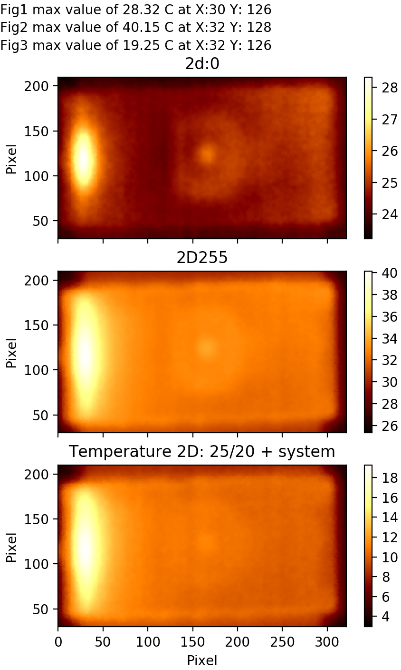
Ambient Temp = 23C
DungeonMasters was running for 1h20min
Dungeon FPS: 35
04/25/2018

